Slide 1


CS520 Data Integration, Warehousing & Governance
Address MANAGEMENT (GeoLocation)
MEMBERS:
- Nirbhay Tibadiya - Architect
- Tirumala Laxmi – Data SCience
- Singh Nitin - DBA

Slide 2
Interest of Domain
Domain: Geolocation /Address Management
Geocoding, especially in the context of a geolocation or address management system, is a significant and valuable domain within the IT industry. Geocoding involves the process of converting addresses or place names into geographic coordinates (latitude and longitude) on a map.
More

Slide 3
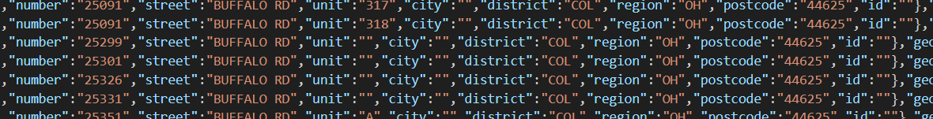
Data Sources
Source | Link | Formate
Open Address | OpenAddresses Batch | JSON
CoreLogic | AddressRight | CoreLogic New Zealand | CSV
Datablist | Download Sample CSV Files for free - Datablist | CSV

Slide 4
Research TOOLS
Vizier , R and RStudio, Git, SMARTY

Slide 5
Data VOLUME

Slide 6
Data Flow

Slide 7
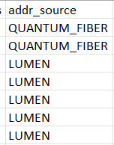
Data Quality Problem
NO | Issue | Technique | Example | Category
1 | System -System Interaction | Generate Unique 15 digits address id for each | Id: 1234567899091 | Data Integration
2 | Data Deduplication | Automatically identify and remove duplicates Use algorithms to detect and merge duplicate address records | 12 Free Way, Manteo, NC 12 FRWY, Manteo, NC | Data Integration
3 | Data Source | Integrate data sources to consolidate address data. Merge address data from various sources into a centralized repository | Open Address CoreLogic DataB list | Data Integration
4 | Stored Source Validation | Validate and store the source of each address |  | Data Governance

Slide 8
NO | Issue | Technique | Example | Category
5 | Data Transformation and Standardization | Standardize data formats and structures. Convert addresses into a common format (e.g., street, city, state, ZIP) | Heterogenous schema Matching | Data Integration
6 | Data Validation | Implement automated validation checks Validate addresses against postal databases and correct discrepancies | Smarty API with Python Script | Data Governance
7 | Geocoding Accuracy | Ensure accurate geocoding for each address Automatically geocode addresses to precise geographic coordinates | Geocoding Function | Data Integration
8 | Audit of Data Updates | Set up an automated audit trail for data updates | Database Triggers | Data Governance
9 | Backtracking Data from Source to Storage | Implement a traceability mechanism to track data from its source to storage | Mapped to source Id | Data Governance

Slide 9

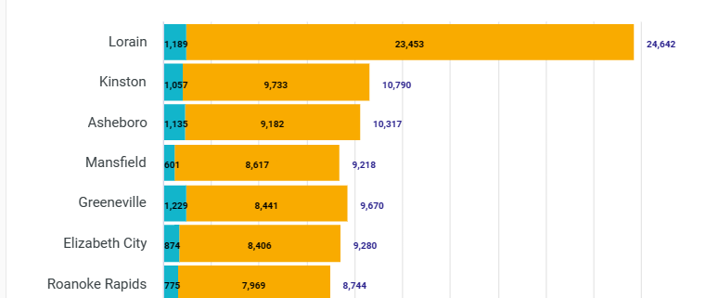
Data Visualization
Address Standardization 123 Freeway San Diago, CA, 91911 123 FreeeWY San Diago, CA, 91911 123 FRWAY San Diago , CA, 91911
123 FRWY San Diago, CA 91911 123 FWY San Dgo, CA 91911
https://pe.usps.com/text/pub28/28apc_002.htm

Slide 10

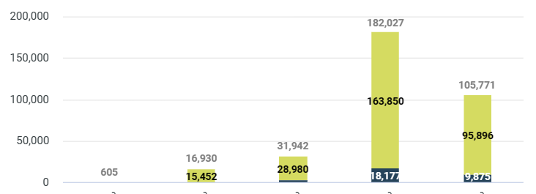
Data Visualization
BLDG/UNIT/SUITE /FLOOR/APT ?
Missing Structure Type value 123 Freeway 1 San Diago, CA, 91911 123 FreeeWY 1 San Diago, CA, 91911 123 FRWAY San #1 Diago , CA, 91911
123 FRWY San -1 Diago, CA 91911 123 FWY San # 1 Dgo, CA 91911

Slide 11
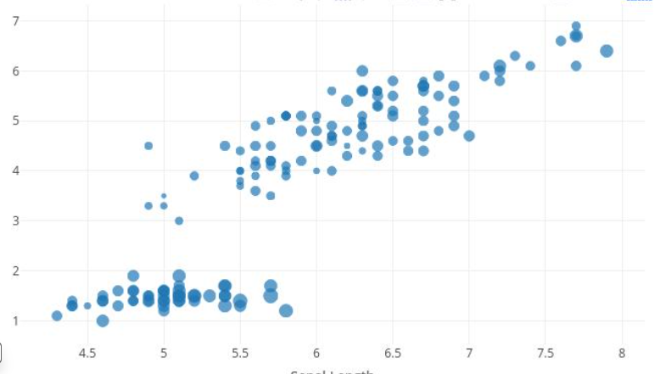

Data Visualization
Latitude and Longitude Outlier
Walking beyond what’s comfortable

Slide 12
Validation TOOL
SMARTYSTERRT | Address Verification APIs (smarty.com)

Slide 13
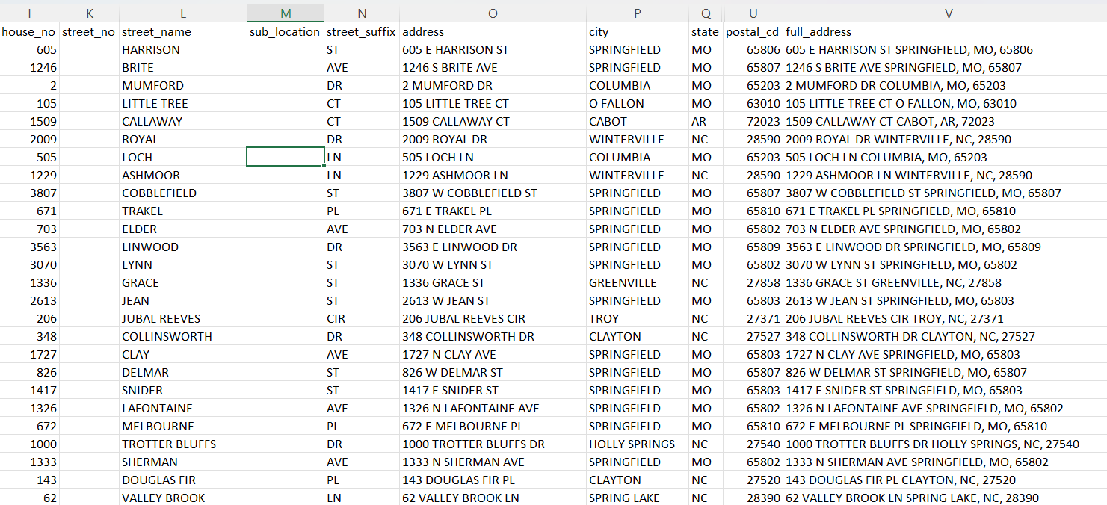



Data Visualization
Group #28

Slide 14
WORKSPACE
Central Repository Master Table schema
Source code:

Slide 15
Question ? THANK YOU!
THE END

